Slide 1
Credit EDA Assignment

Slide 2
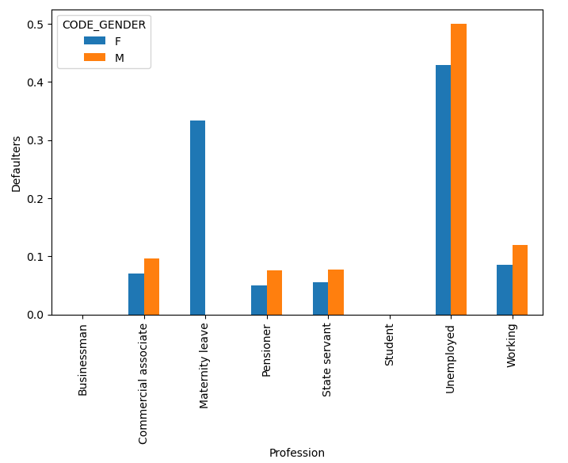
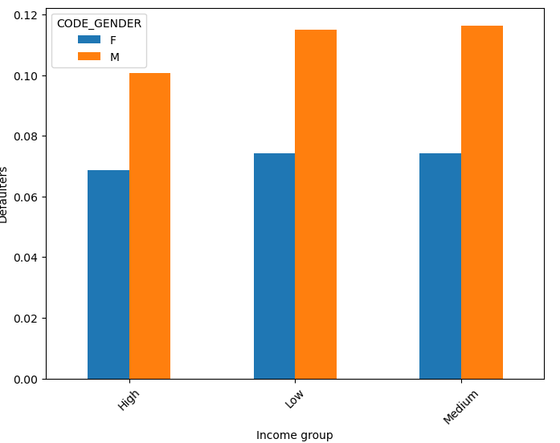
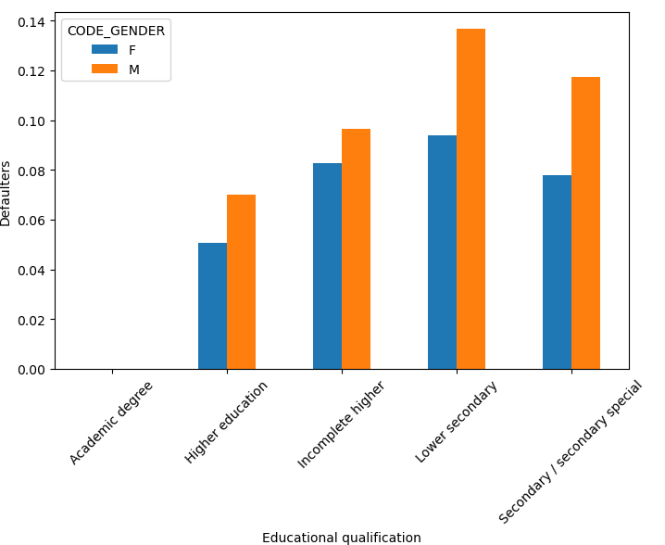
Current application
Profession and gender
Income Group Education qualification
Unemployed people are highly defaulted
Males are more likely defaulted than Females
Lower educated people are highly defaulted

Slide 3
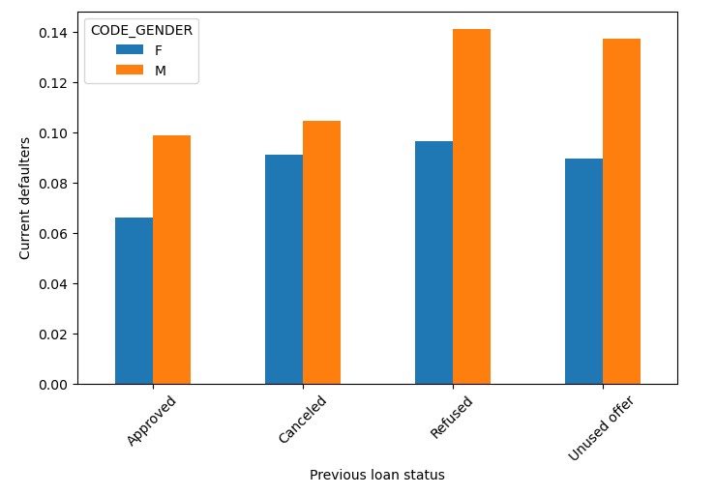
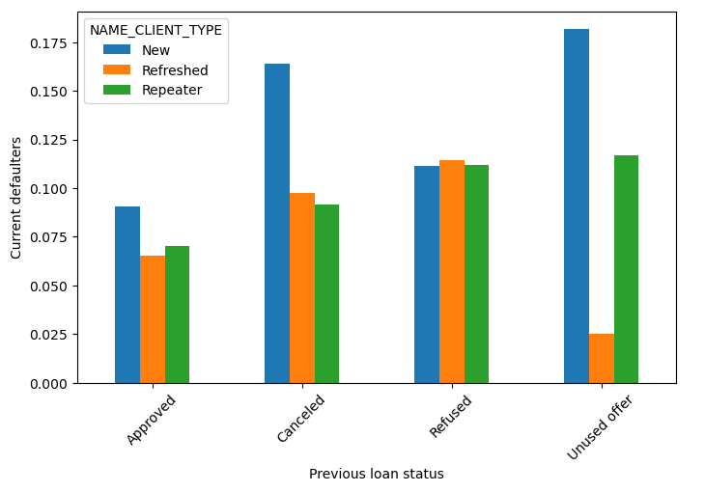
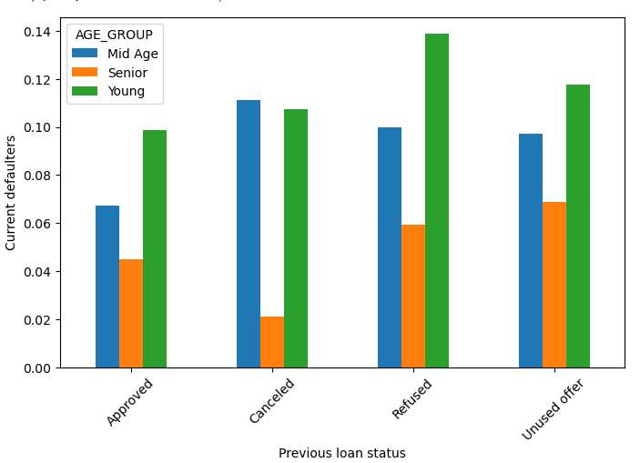
Previous Application
Previous loan status & gender Previous loan status & client type Age group & loan status
Young people and Male who were previously refused are mostly defaulted
New people with unused offers are mostly defaulted
Males who are previously refused and unused offer are mostly defaulted.

Slide 4
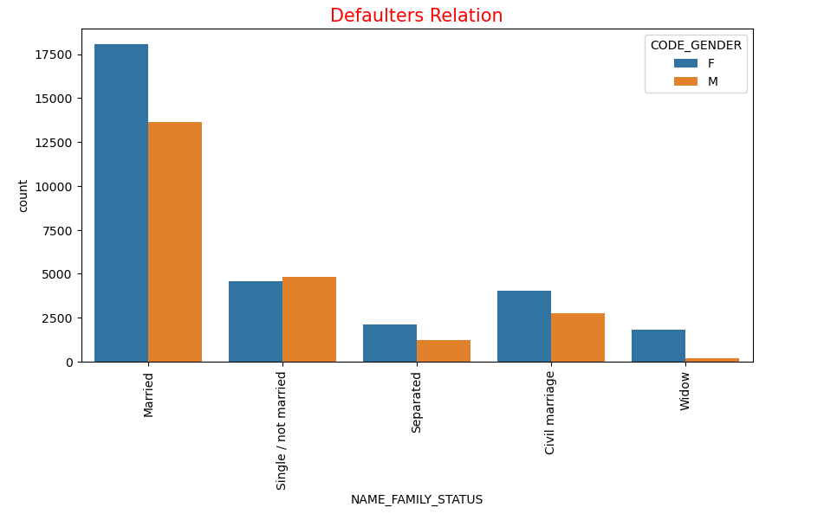
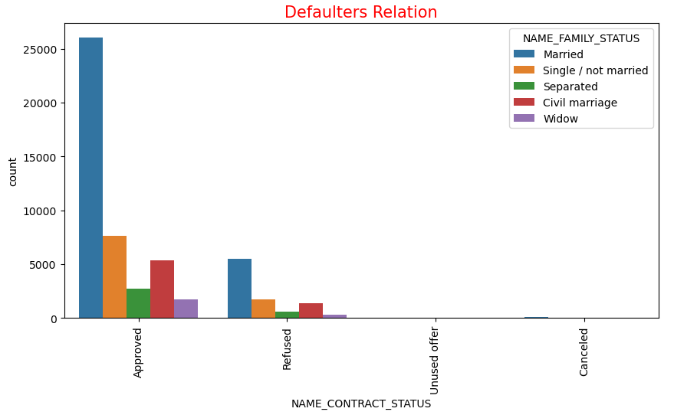
Merged Data
Relationship status Family Status
Married people are less likely to pay the loan bill compared to single and separated people.
More no of approved people are married.

Slide 5
Conclusion
Female Gender are more likely to not face payment difficulties then the male and hence it is recommended to approve more loans of Female Gender than the male gender.
The Repeater applicant has High chance of non-Defaulting and also has high chance of defaulting when compared to new applicants.
Secondary/ secondary special people with education are struggling to pay their loan bill and becoming defaulters.

